Slide 1


Swar
Voice-Based Email & Messaging Assistant
Enabling Hands-Free Communication for All
Presenting by: Aditya Singh
Under the guidance of: Dr. Santhiya Krishnasamy
For the purpose of: Infosys Springboard Virtual Internship

Slide 2

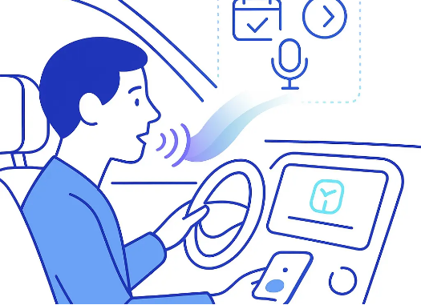
Why Swar??
The Problem:
Digital communication is fundamentally broken for two groups:
•
Visually Impaired Users: Navigating complex screens with screen readers is frustrating and slow.
•
Multitasking Professionals: You can't safely read emails while driving or cooking.
Vision:
To completely remove the screen from the equation. I wanted to build an assistant that you don't just use, but talk to.

Slide 3







Our Approach (Methodology)
User-First Design
Privacy-First
Agile Sprints
We started by asking, "What if the user has no keyboard?" This drove our decision to enable the microphone immediately handling "Wake Words".
Instead of sending your face data to the cloud, I chose to process it locally using OpenCV. It's safer and faster.
Broke the massive 8-week goal into bite-sized 2-week milestones to ensure we always had working code.

Slide 4
Where We Are Going (Roadmap)
Milestone 1 (Now)
Milestone 2
Milestone 3
Milestone 4
The Foundation
Biometric login, database schemas, and voice loops.
The Connector
Hooking up Swar to Gmail so it can actually read your inbox.
The Brain
Adding AI to summarize long message threads specifically for WhatsApp.
The Shield
Dockerizing the app and adding Voice PINs for 2-Factor Authentication.

Slide 5



Milestone 1 Achievements
"Look to Login"
Smart reading
Secure Backbone
I completely removed passwords. The camera identifies you instantly, making access zero-touch.
The system remembers reads the mail and message for you smoothly.
Designed a database ready for the future, capable of handling not just emails but WhatsApp threads too.

Slide 6
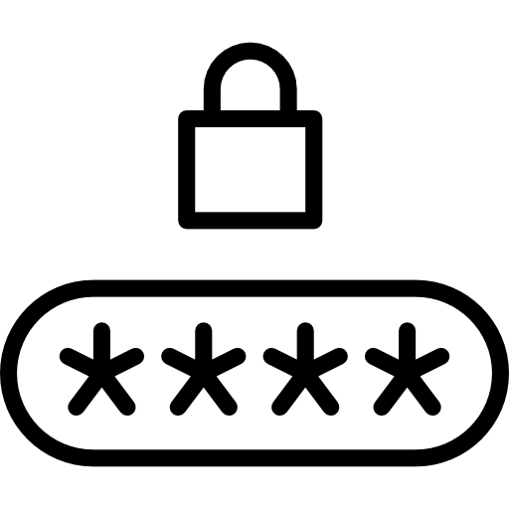


Milestone 2 Achievements
Voice PIN
Compose & send email
NLU implementation
Added 2FA by adding another Voice PIN as additional user authentication.
The system can compose the mail and sent it to the recipient on your voice command.
Implemented NLU so that system can easily recognized and understand the user commands.

Slide 7
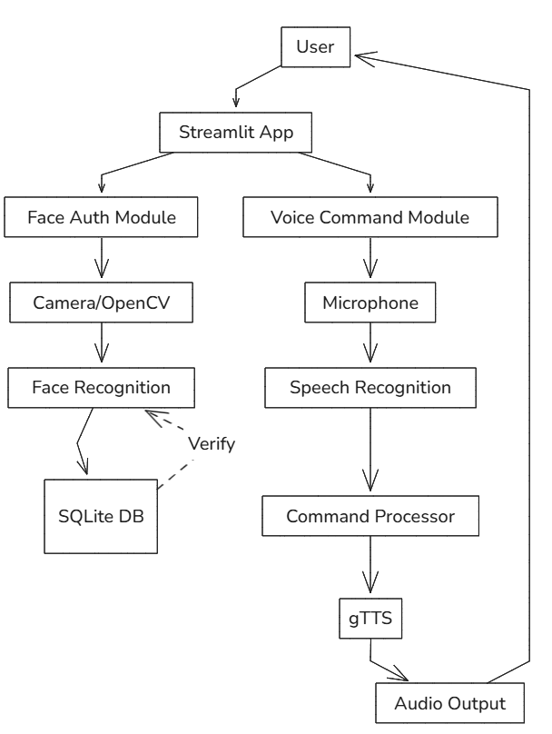
System Architecture
Frontend: Streamlit Web UI
Backend: Python Application Logic
Computer Vision: OpenCV + Face Recognition
Speech Pipeline: SpeechRecognition (ASR) + gTTS (TTS)+NLU
Database: SQLite (User Details + Face Encodings)
The Senses:
Ears: Google Speech Recognition API.
•
•
Voice: gTTS (Google Text-to-Speech).
•
Eyes: OpenCV for Face Recognition.

Slide 8
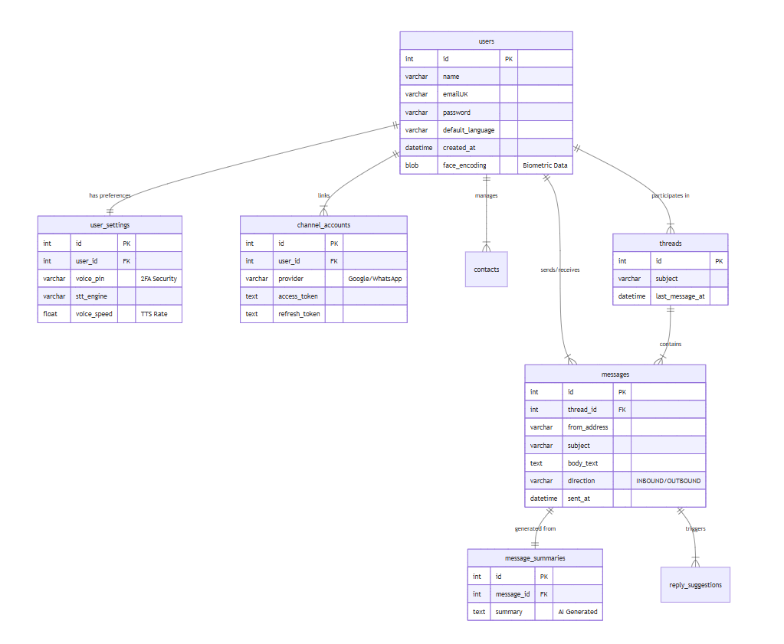

Database Design
Built for Scale:
We didn't just build a user table. We designed a Relationship-First Schema:
•
Unified Inbox: A single messages table that can hold emails AND chat messages.
•
Channel Agnostic: Specifically designed channel_accounts to link multiple providers (Gmail, Outlook) to one user.

Slide 9



Tools & Resources Spec
Streamlit
Face_Recognition
SQLite
For its ability to handle real-time data reruns (st.rerun()) effectively.
We selected this specific library because it uses a HOG (Histogram of Oriented Gradients) model which provides 99% accuracy with low latency.
Chosen for Milestone 1 speed, but our SQL is standard enough to swap for PostgreSQL in Milestone 4.

Slide 10
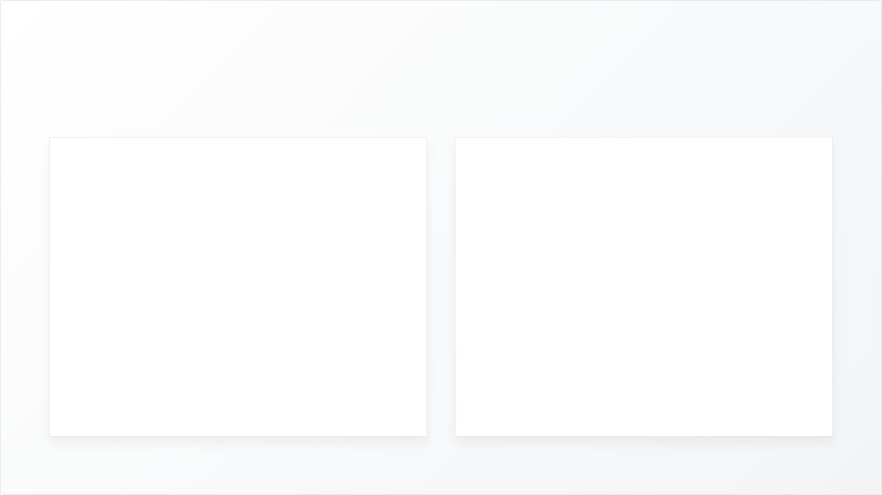
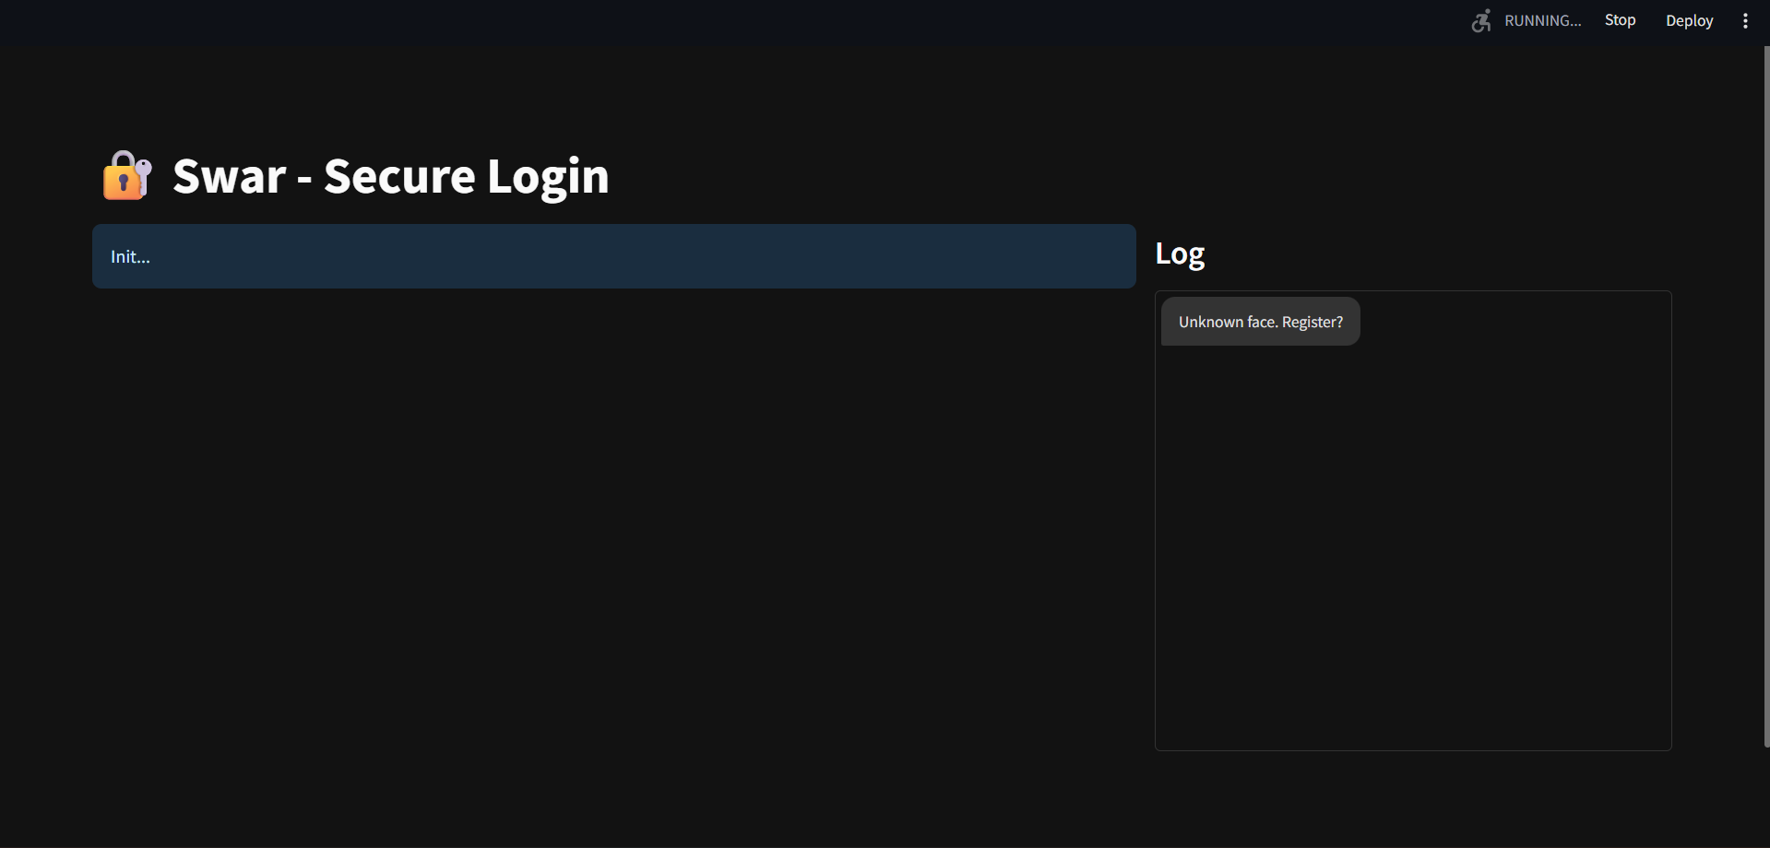
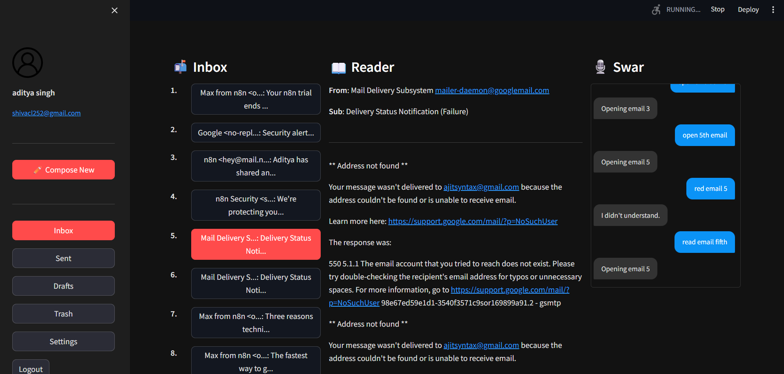
Glimpses
Look to Login Interface
Inbox page

Slide 11




Future Scope
Integrating chat apps, summarizer
Remaining Milestones
Integration of WhatsApp, and telegram chat and multi-language support along with auto-reply and summarizer.
Integration of advanced AI summarization and robust Docker containerization for seamless deployment.

Slide 12
THANK YOU

